Slide 1
Sql Server 2000 (Language) and Stored Procedure
Training Session
By
Siddharth Kumar Sinha

Slide 2
Agenda
Day 1 –Introduction Of Sql Server 2000 and Database Concepts
Day 2 – Queries , Stored Procedure and Cursor

Slide 3
Day 2
Queries , Stored Procedure and Cursor

Slide 4
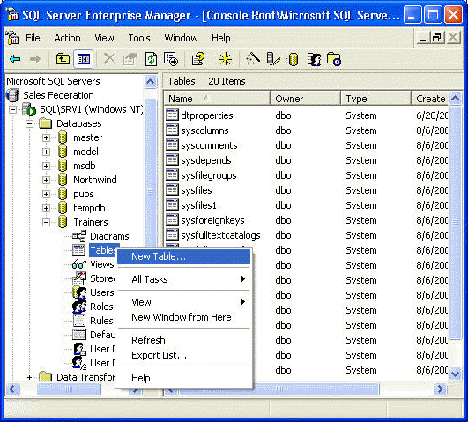
Creating Tables
Start by opening Enterprise Manager, expand the server and database you would like to add a table too, then right click "Tables" and select "New Table..." from the menu.

Slide 5
Field properties
A phone no. looks different from date. a full featured database such as Sql server lets you capture these differences by specifying field properties.
Design view of the table shows four important properties for each field in the table.

Slide 6
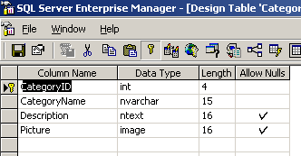
Field properties
Column name
Data type
Length
Allow Nulls

Slide 7
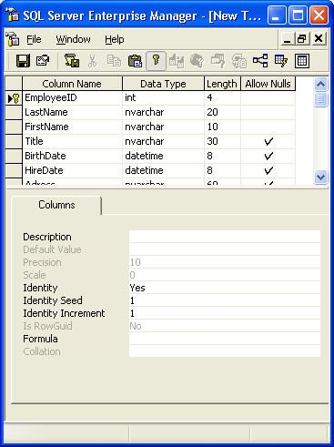
Table Options
Description - is a space for you to enter any
Default Value - is the value that will be entered if no other value is specified
Precision/Scale - used to set the precision
Identity/Seed/Increment - Similar to the AutoNumber
Is RowGuid - Specifies that this column contains the GUID
Formula –as LastName & ', ' & FirstName

Slide 8
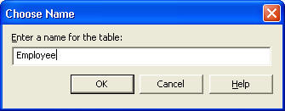
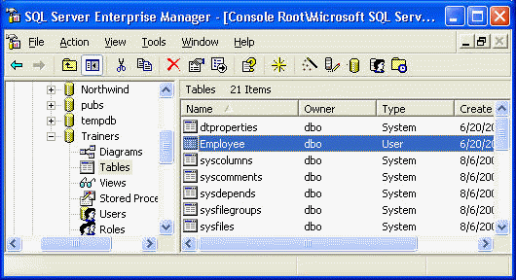
Saving Table
Once you have added all the columns you can click the save icon (left most, looks like a disk) on the toolbar and you will be prompted to enter a name for this table

Slide 9
Create Table Query
CREATE TABLE [employee] (
[emp_id] [empid] NOT NULL , [fname] [varchar] (20), [minit] [char] (1), [lname] [varchar] (30), [job_id] [smallint], [job_lvl] [tinyint], [pub_id] [char] (4) , [hire_date] [datetime],
CONSTRAINT [PK_emp_id] PRIMARY KEY NONCLUSTERED
( [emp_id] ) ON [PRIMARY] ,
FOREIGN KEY
([job_id] ),
CONSTRAINT [CK_emp_id] CHECK ([emp_id] like '[A-Z][A-Z][A-Z][1-9][0-9][0-9][0-9][0-9]’)
) ON [PRIMARY]
GO

Slide 10
Alter Table Query
To change the structure of the table as to add a column or drop a column or put some constrain on a column.
ALTER TABLE MyTable ALTER COLUMN
NullCOl NVARCHAR(20) NOT NULL
ALTER TABLE doc_exa ADD
column_b VARCHAR(20) NULL
ALTER TABLE doc_exb DROP COLUMN
column_b

Slide 11
INSERT
Adding Rows with INSERT
The INSERT statement adds one or more new rows to a table.
USE PUBS
CREATE TABLE T1 ( column_1 int, column_2 varchar(30))
INSERT T1 VALUES (1, 'Row #1')
Or
INSERT T1 (column_2, column_1) VALUES ('Row #1',1)
INSERT INTO T1 (column_2, column_1) VALUES ('Row #1',1)

Slide 12
UPDATE
The UPDATE statement updates one or more existing rows to a table as per the requirement and criteria.
UPDATE authors
SET authors.au_fname = 'Annie'
WHERE au_fname = 'Anne'

Slide 13
DELETE
The DELETE statement Delete one or more existing rows to a table as per the requirement and criteria.
DELETE FROM authors
WHERE au_lname = 'McBadden'

Slide 14
Select Queries
SELECT
Retrieves rows from the database and allows the selection of one or many rows or columns from one or many tables.
SELECT select_list
[ INTO new_table ]
FROM table_source
[ WHERE search_condition ]
[ GROUP BY group_by_expression ]
[ HAVING search_condition ]
[ ORDER BY order_expression [ ASC | DESC ] ]

Slide 15
Select Queries
Choosing All Columns And Specific Columns
The asterisk (*) has a special meaning in SELECT statements
SELECT * FROM [Order Details]
Explicitly list all the column names in the table
SELECT OrderID,
ProductID,
UnitPrice,
Quantity, Discount
FROM [Order Details]
ORDER BY OrderID ASC

Slide 16
Select Queries
Constant in query
It is usually more efficient for an application itself to build the constant value into the results when they are displayed
USE PUBS
SELECT
LastName + ', ' + FirstName AS EmployeeName
FROM Northwind.dbo.Employees

Slide 17
Select Queries
Where Clause
Specifies a search condition to restrict the rows returned.
USE Northwind
SELECT
UnitsInStock,
ProductID,
ProductName
FROM Northwind.dbo.Products
WHERE UnitsInStock = 15

Slide 18
Select Queries
Group By Clause
Specifies the groups into which output rows are to be placed
If aggregate functions are included in the SELECT clause <select list>, calculates a summary value for each group.
USE pubs
SELECT type,
pub_id,
AVG(price) AS AVG PRICE',
sum(ytd_sales) AS ‘TOTAL SALES'
FROM titles
GROUP BY type, pub_id

Slide 19
Select Queries
Choosing Rows with the HAVING Clause
The HAVING clause sets conditions on the GROUP BY clause similar to the way WHERE interacts with SELECT.
The HAVING search condition is applied after the “grouping operation”.
HAVING clauses can reference any of the items that appear in the select list.

Slide 20
Select Queries
ORDER BY
Specifies the sort order used on columns returned in a SELECT
USE Pubs
SELECT type,
pub_id,
AVG(price) AS AVG PRICE',
SUM(ytd_sales) AS ‘TOTAL SALES'
FROM titles
GROUP BY type, pub_id
ORDER BY type, pub_id ASC--DESC

Slide 21
Select Queries
With ROLLUP
The ROLLUP operator is useful in generating reports that contain subtotals and totals.
USE PUBS
SELECT type,
pub_id,
sum(ytd_sales) AS 'TOTAL SALES'
FROM titles
GROUP BY type, pub_id
WITH ROLLUP

Slide 22
Select Queries
COMPUTE Clause
Generates totals that appear as additional summary columns at the end of the result set.
USE pubs
SELECT type,
price,
advance
FROM titles
ORDER BY type
COMPUTE SUM (price)

Slide 23
Select Queries
TOP N PERCENT
Limiting Result Sets Using TOP and PERCENT.
The TOP clause limits the number of rows returned in the result set.
USE pubs
    SELECT top 10 * FROM authors
    SELECT top 10 percent * FROM authors

Slide 24
Select Queries
BETWEEN CLAUSE
A range search is one that returns all values between two specified values.
The results of this SELECT statement contain any products that have either 10 or 20 units in stock.
SELECT UnitsInStock,
ProductID,
ProductName
FROM Northwind.dbo.Products
WHERE UnitsInStock > 10 AND UnitsInStock < 20
ORDER BY UnitsInStock

Slide 25
Select Queries
INTO CLAUSE -
With it You can transfer the Selected output in a table and you are not supposed to create the table.
USE NORTHWIND
DROP TABLE HCLTABLE --remove the table
SELECT COUNT(*) as NO_OF_ROWS ,
NEWID() as ID_NO,
SUM(UnitPrice) AS [TOTAL SUM]
INTO HCLTABLE
FROM [Order Details]
SELECT * FROM HCLTABLE

Slide 26
Select Queries
FOR XML AUTO
Results as XML rather than standard rowsets.
This Clause is valid only in the SELECT and not valid in COMPUTE BY or FOR BROWSE, view definition , cursors and for further processing in a stored procedure
USE pubs
SELECT type,
price,
advance
FROM titles
FOR XML AUTO

Slide 27
Select Queries –If..Else
USE pubs
IF
(SELECT AVG(price) FROM titles WHERE type = 'mod_cook') < 15
BEGIN
PRINT 'The following titles are excellent mod_cook books.'
END
ELSE
PRINT 'Average title price is more than $15.'

Slide 28
Select Queries –Case
USE pubs
SELECT Category =
CASE type WHEN 'popular_comp' THEN 'Popular Computing' WHEN 'mod_cook' THEN 'Modern Cooking‘
WHEN 'business' THEN 'Business'
WHEN 'psychology' THEN 'Psychology'
ELSE
'Not yet categorized'
END,
CAST(title AS varchar(25)) AS 'Shortened Title
FROM titles

Slide 29
SOME WILD CARDS
Pattern Meaning
% Any string of zero or more character
- Any single Character
[a-d] Any char within the range
[aef] A single char a, e or f
[^a-d] Any single char except those in the range of a to d, inclusive
[^aef] Any single char except a, e or f

Slide 30
Views
Views
A view is a virtual table whose contents are defined by a query.
Like a real table, a view consists of a set of named columns and rows of data.
A view does not exist as a stored set of data values in a database.
The rows and columns of data come from tables referenced in the query defining the view and are produced dynamically when the view is referenced.

Slide 31
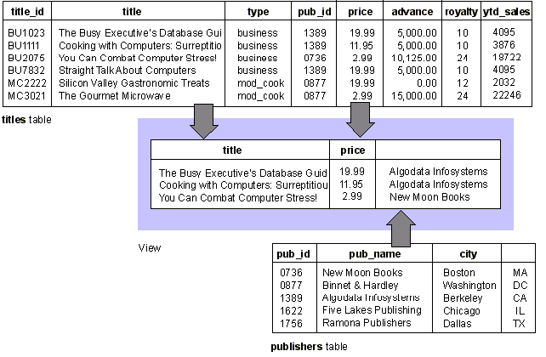
Views

Slide 32
Joins
The JOIN is a SQL command used to retrieve data from 2 or more database tables with existing relationship based upon a common attribute.
  Inner join
  Outer join
    Left outer join
    Right outer join
    Full outer join
    Cross join

Slide 33
Joins
Inner join –
A join that displays only the rows that have a match in both joined tables. (This is the default type of join in the Query Designer.)
For example, you can join the titles and publishers tables to create a result set that shows the publisher name for each title. In an inner join, titles for which you do not have publisher information are not included in the result set, nor are publishers with no titles.
Note - Columns containing NULL do not match any values when you are creating an inner join and are therefore excluded from the result set. Null values do not match other null values.

Slide 34
Joins
Inner join- Titles for which you do not have publisher information are not included in the result set
USE Pubs
SELECT titles.pub_id as titles_pub_id,
publishers.pub_id as publishers_pub_id,
title,
pub_name
FROM
titles INNER JOIN publishers
ON
titles.pub_id = publishers.pub_id

Slide 35
Joins
Outer join
A join that includes rows even if they do not have related rows in the joined table. You can create three variations of an outer join to specify the unmatched rows to be included
        Left outer join
        Right outer join
        Full outer join

Slide 36
Joins
Left outer join
All rows from the first-named table (the "left" table, which appears leftmost in the JOIN clause) are included.
Unmatched rows in the right table do not appear.
For example, the following SQL statement illustrates a left outer join between the titles and publishers tables to include all titles, even those you do not have publisher information

Slide 37
Joins
Left outer join- Unmatched rows in the right table do not appear.
USE Pubs
SELECT
titles.title_id,
titles.title,
publishers.pub_name
FROM
titles LEFT OUTER JOIN publishers
ON
titles.pub_id = publishers.pub_id

Slide 38
Joins
Right outer join
All rows in the second-named table (the "right" table, which appears rightmost in the JOIN clause) are included.
Unmatched rows in the left table are not included.
For example, a right outer join between the titles and publishers tables will include all publishers, even those who have no titles in the titles table.

Slide 39
Joins
Right outer join - Unmatched rows in the left table are not included.
USE Pubs
SELECT
titles.title_id,
titles.title,
publishers.pub_name
FROM
titles RIGHT OUTER JOIN publishers
ON
titles.pub_id = publishers.pub_id

Slide 40
Joins
Full outer join
All rows in all joined tables are included, whether they are matched or not.
For example, a full outer join between titles and publishers shows all titles and all publishers, even those that have no match in the other table.

Slide 41
Joins
Full outer join - titles and all publishers, even those that have no match
USE Pubs
SELECT titles.title_id,
titles.title,
publishers.pub_name
FROM
titles FULL OUTER JOIN publishers
ON
titles.pub_id = publishers.pub_id

Slide 42
Joins
Cross join
A join whose result set includes one row for each possible pairing of rows from the two tables.
For example, authors CROSS JOIN publishers yields a result set with one row for each possible author/publisher combination.

Slide 43
Joins
Cross join -one row for each possible author/publisher combination
Use pubs
SELECT *
FROM
authors CROSS JOIN publishers

Slide 44
Stored Procedure
Stored Procedure
    It is a set of SQL statements stored within a database server and is executed as single entity.
Using stored procedures has several advantages over using inline SQL statements, like improved performance and separation of the application logic layer from database layer in n-tier applications.
A Transact-SQL stored procedure is a set of T-SQL code that is stored in a SQL Server database and compiled when used. You create this set of code using the CREATE PROCEDURE command

Slide 45
Stored Procedure
Stored Procedure Advantages
Although you can do most of the things a stored procedure can do with simple ad hoc Transact-SQL code, stored procedures have a number of advantages over ad hoc queries, including
  Encapsulation of business rules and policies
  Application modularization
  Access to database objects that is both secure and uniform
  Accept input parameters and return multiple values in the form of output parameters to the calling procedure or batch
  Contain programming statements that perform operations in the database, including calling other procedures.

Slide 46
Stored Procedure
Types of Stored Procedures
There are three types of stored procedures.
Microsoft supplies several stored procedures to manipulate and administrate the database.
Apart from them can write custom stored procedure to use them in our application level.
    System stored procedures
    Extended stored procedures
    Custom stored procedures

Slide 47
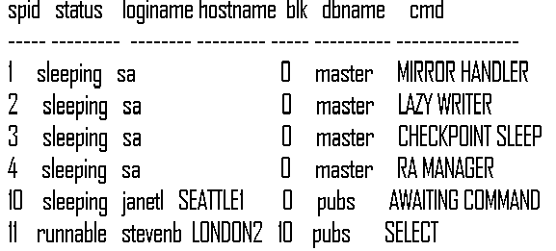
Stored Procedure
System stored procedures
System stored procedures are mainly used for administrating, assisting, configuring and monitoring the SQL server.
USE master
EXEC sp_who

Slide 48
Stored Procedure
Extended stored procedures
Extended stored procedures are used to access SQL server by using dlls.
We can use C or C++ to write extended stored procedures with Dlls. One good example operating system commands on SQL server. We use a stored procedure “xp_cmdshell “ to run a DOS command.
USE Master
    xp_cmdshell "dir c:\“
will list the files in the root directory of C drive
    exec xp_logininfo

Slide 49
Stored Procedure
Custom stored procedures
These are the stored procedures we write.
There are several advantages in writing our own stored procedures.
We are able to write complex and nested statements with less effort.
A result set for each SELECT statement contained in the stored procedure or any other stored procedures called by the stored procedure.
A cursor can be used in Stored Procedure

Slide 50
Stored Procedure
Stored Procedure Without Parameter
CREATE PROCEDURE sqltest
WITH RECOMPILE
AS
SELECT [title_id],
[title],
[type]
FROM TITLES
GO

Slide 51
Stored Procedure
Stored Procedure With Parameter (INPUT ONLY)
CREATE PROCEDURE TITLES_TYPE_WISE
@TYPE AS VARCHAR(30)
AS
SELECT title_id,
title,
type
FROM TITLES
WHERE TYPE=@TYPE

Slide 52
Stored Procedure
Stored Procedure With Parameter (INPUT AND OUTPUT BOTH)
CREATE PROCEDURE DebugA ( @IntIn INT, @IntOut INT OUTPUT )
AS
Set @IntOut = @IntIn + 10
Return
To execute the Stored Procedure
DECLARE @INTOUTPUT AS INT
EXEC DebugA 10,@INTOUTPUT OUTPUT
SELECT @INTOUTPUT AS VALUE

Slide 53
Stored Procedure
Stored Procedure Using Cursor
Short for Current Set Of Records in some database languages. The cursor is a database object pointing to a currently selected set of records

Slide 54
Cursor
Cursor is a database object used by applications to manipulate data in a set on a row-by-row basis, instead of the typical SQL commands that operate on all the rows in the set at one time.
For example, you can use cursor to include a list of all user databases and make multiple operations against each database by passing each database name as a variable.

Slide 55
Cursor
USE pubs
declare @Auth_Last as varchar(30)
DECLARE authors_cursor CURSOR FOR
SELECT au_lname FROM authors WHERE au_lname LIKE 'B%'
OPEN authors_cursor -- Perform the first fetch.
FETCH NEXT FROM authors_cursor into @Auth_Last
-- Check @@FETCH_STATUS to see if there are any more rows to fetch.
WHILE @@FETCH_STATUS = 0
BEGIN -- This is executed as long as the previous fetch succeeds.
SELECT @Auth_Last as Auth_Last
FETCH NEXT FROM authors_cursor into @Auth_Last
END
CLOSE authors_cursor
DEALLOCATE authors_cursor
GO

Slide 56
String Functions
  Encrypting Procedure Definitions
  If you are creating a stored procedure and you want to make sure that the procedure definition cannot be viewed by other users, you can use the
  WITH ENCRYPTION clause.
  The procedure definition is then stored in an unreadable form.
  CREATE PROCEDURE vwEncrypted
  WITH ENCRYPTION
  AS
  SELECT CompanyName, ContactName
  FROM Customers

